Slide 1
Photonic measurement of gas pressure.
Arbeitsgruppe 7.55
André Kussicke

Slide 2
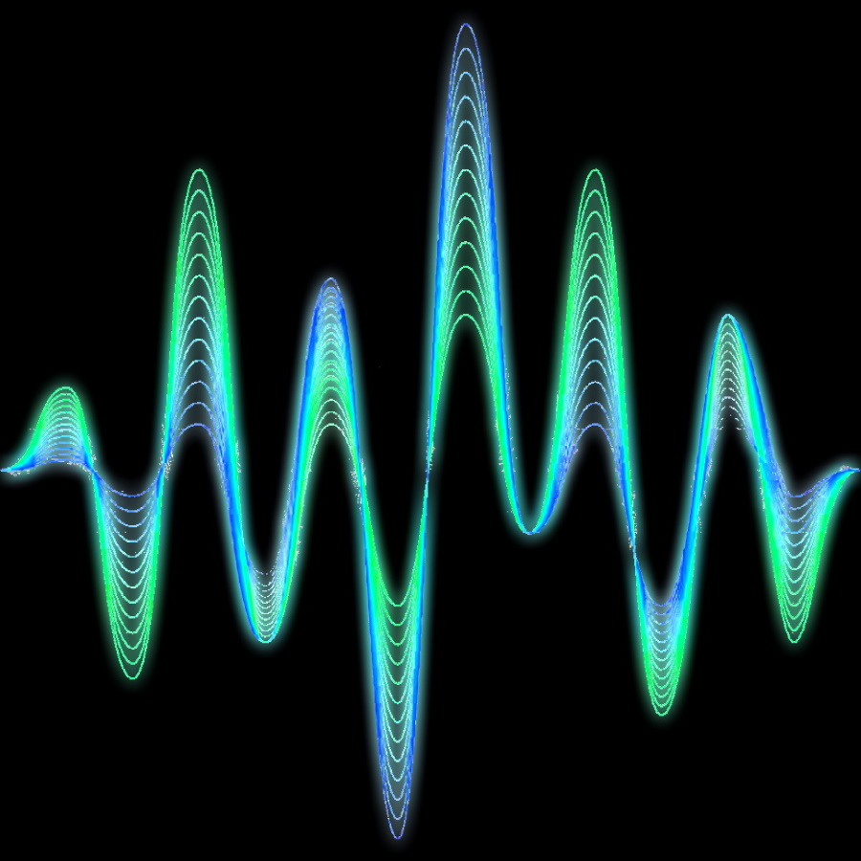
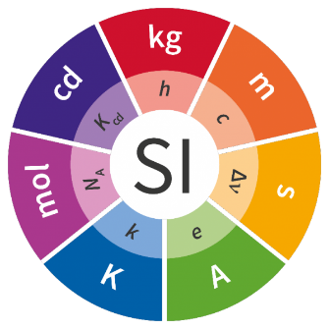
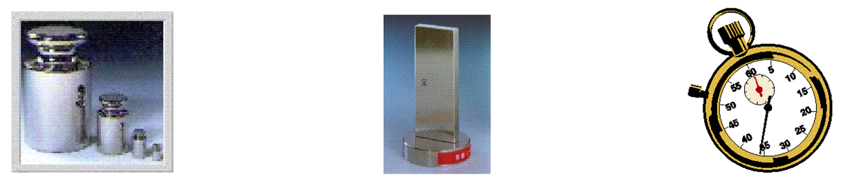
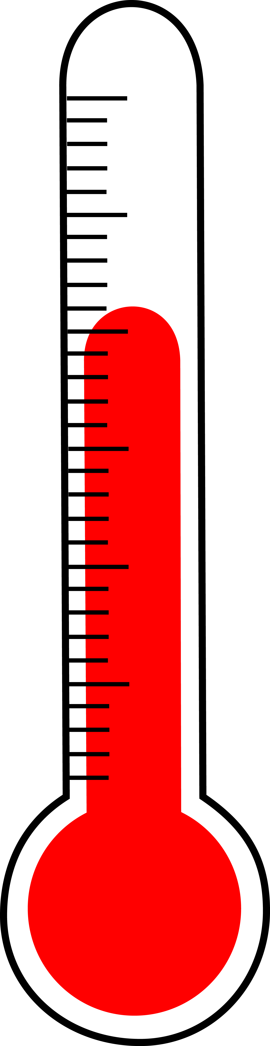
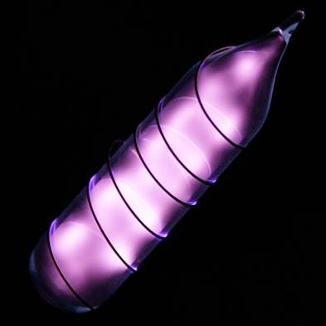
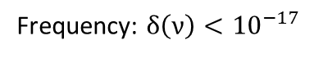
Motivation of the „QuantumPascal“ Project
Usefull in vacuum
Frequency: $δ\left(ν\right)<{10}^{−17}$
New SI: u(k) = 0
Status Quo:
Force per area
Methods based on density measurements
Helium
New theory
u(n_{He}−1) < 10⁻⁶
kg
m
s
K
m
s

Slide 3
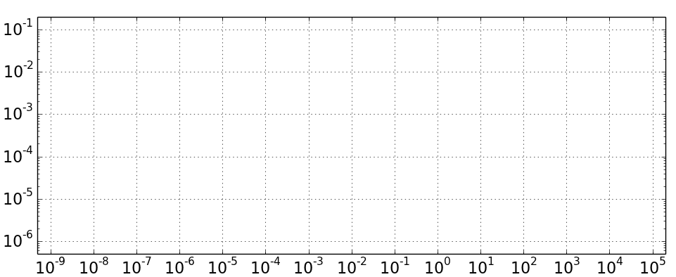
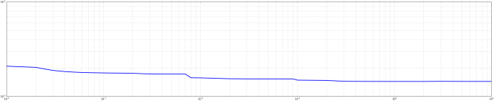
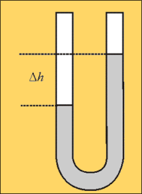
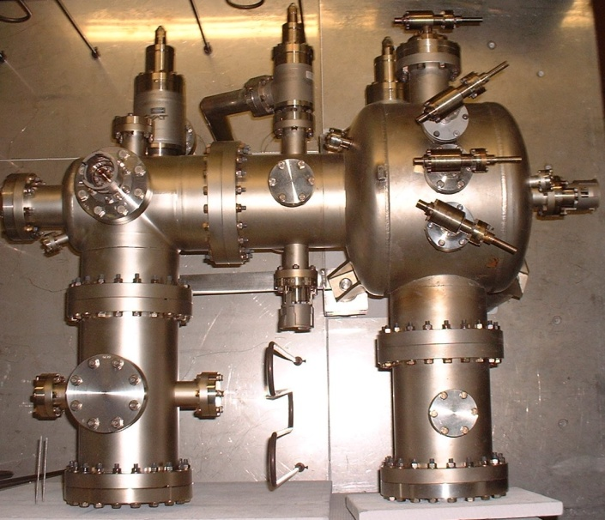
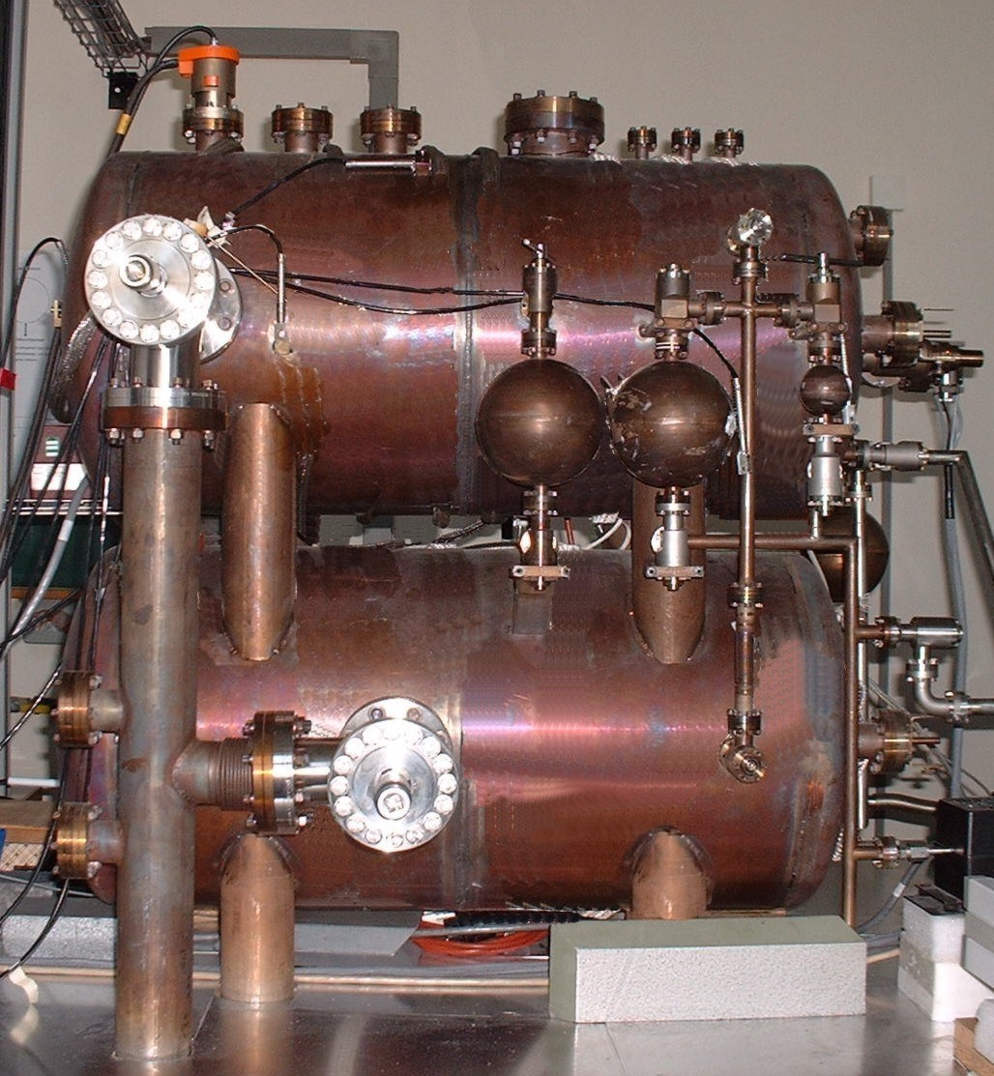
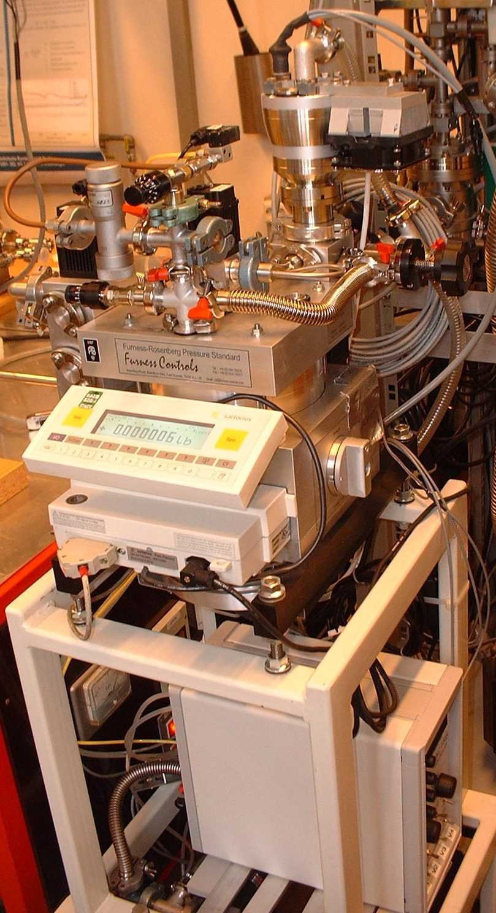
Quantum Pascal Project: Goals
Status Quo – Established methods
AG 7.54 – Vacuum Metrology
AG 3.33
Hg-Manometer
Schwien (BS)
Continious Expansion
Static Expansion
Relative uncertainties
Pressure-
gauge
Pressure (Pa)
Design new optical pressure standards.

Slide 4
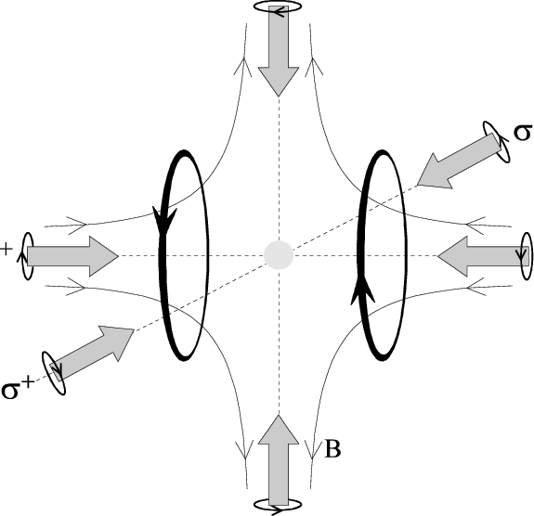
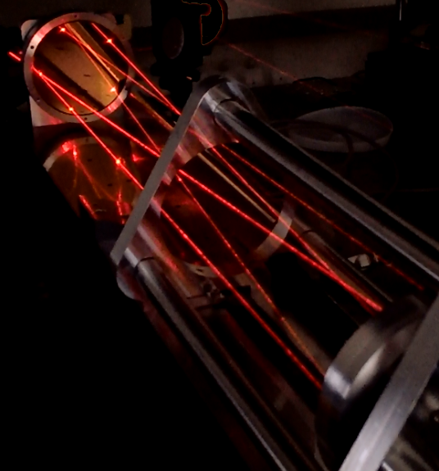
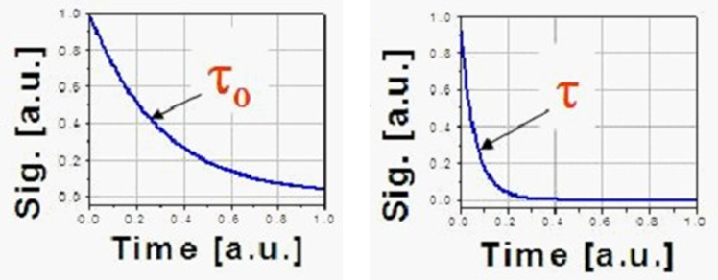
New photonic methods
AG 7.54 – Vacuum Metrology
AG 3.33
Continious Expansion
Static Expansion
Pressure balance
relative uncertainties
Hg-Manometer
Schwien (BS)
Magneto-
optic
traps
Absorption-spectroscopy
with Herriott-Cells (CO₂)
Cavity-Ring-Down-
Spectroscopy (CO₂)
Refractivity measurements
(He, Ar & N₂)
Pressure (Pa)

Slide 5
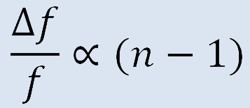
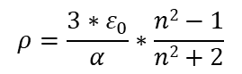
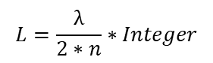
Measurement principle
Lock-In-Technique feedback loop
T
Thermostatisation
Double-resonator
Laser 1
Lock-In-technique and
frequency measurement
Laser 2
Pure gases
$$L=\frac{λ}{2∗n}∗Integer$$
Differential pressure measurement
Gases: He, Ne, Ar
Fabry-Perot-Resonator
Measurement of the refractivity by using the frequency difference.
Calculation of the partial pressure using the ideal or real gas law.
$$ρ=\frac{3∗ε_{0}}{α}∗\frac{n2−1}{n2+2}$$
p$=ρ∗k_{B}∗T∗\left(1+B(T)∗ρ+C(T)∗ρ2+...\right)$

Slide 6
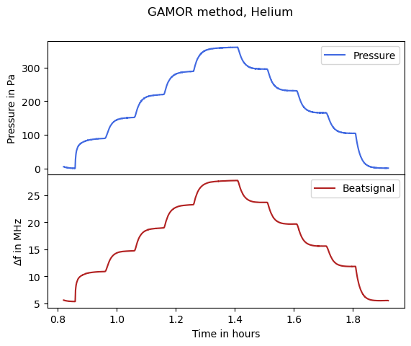
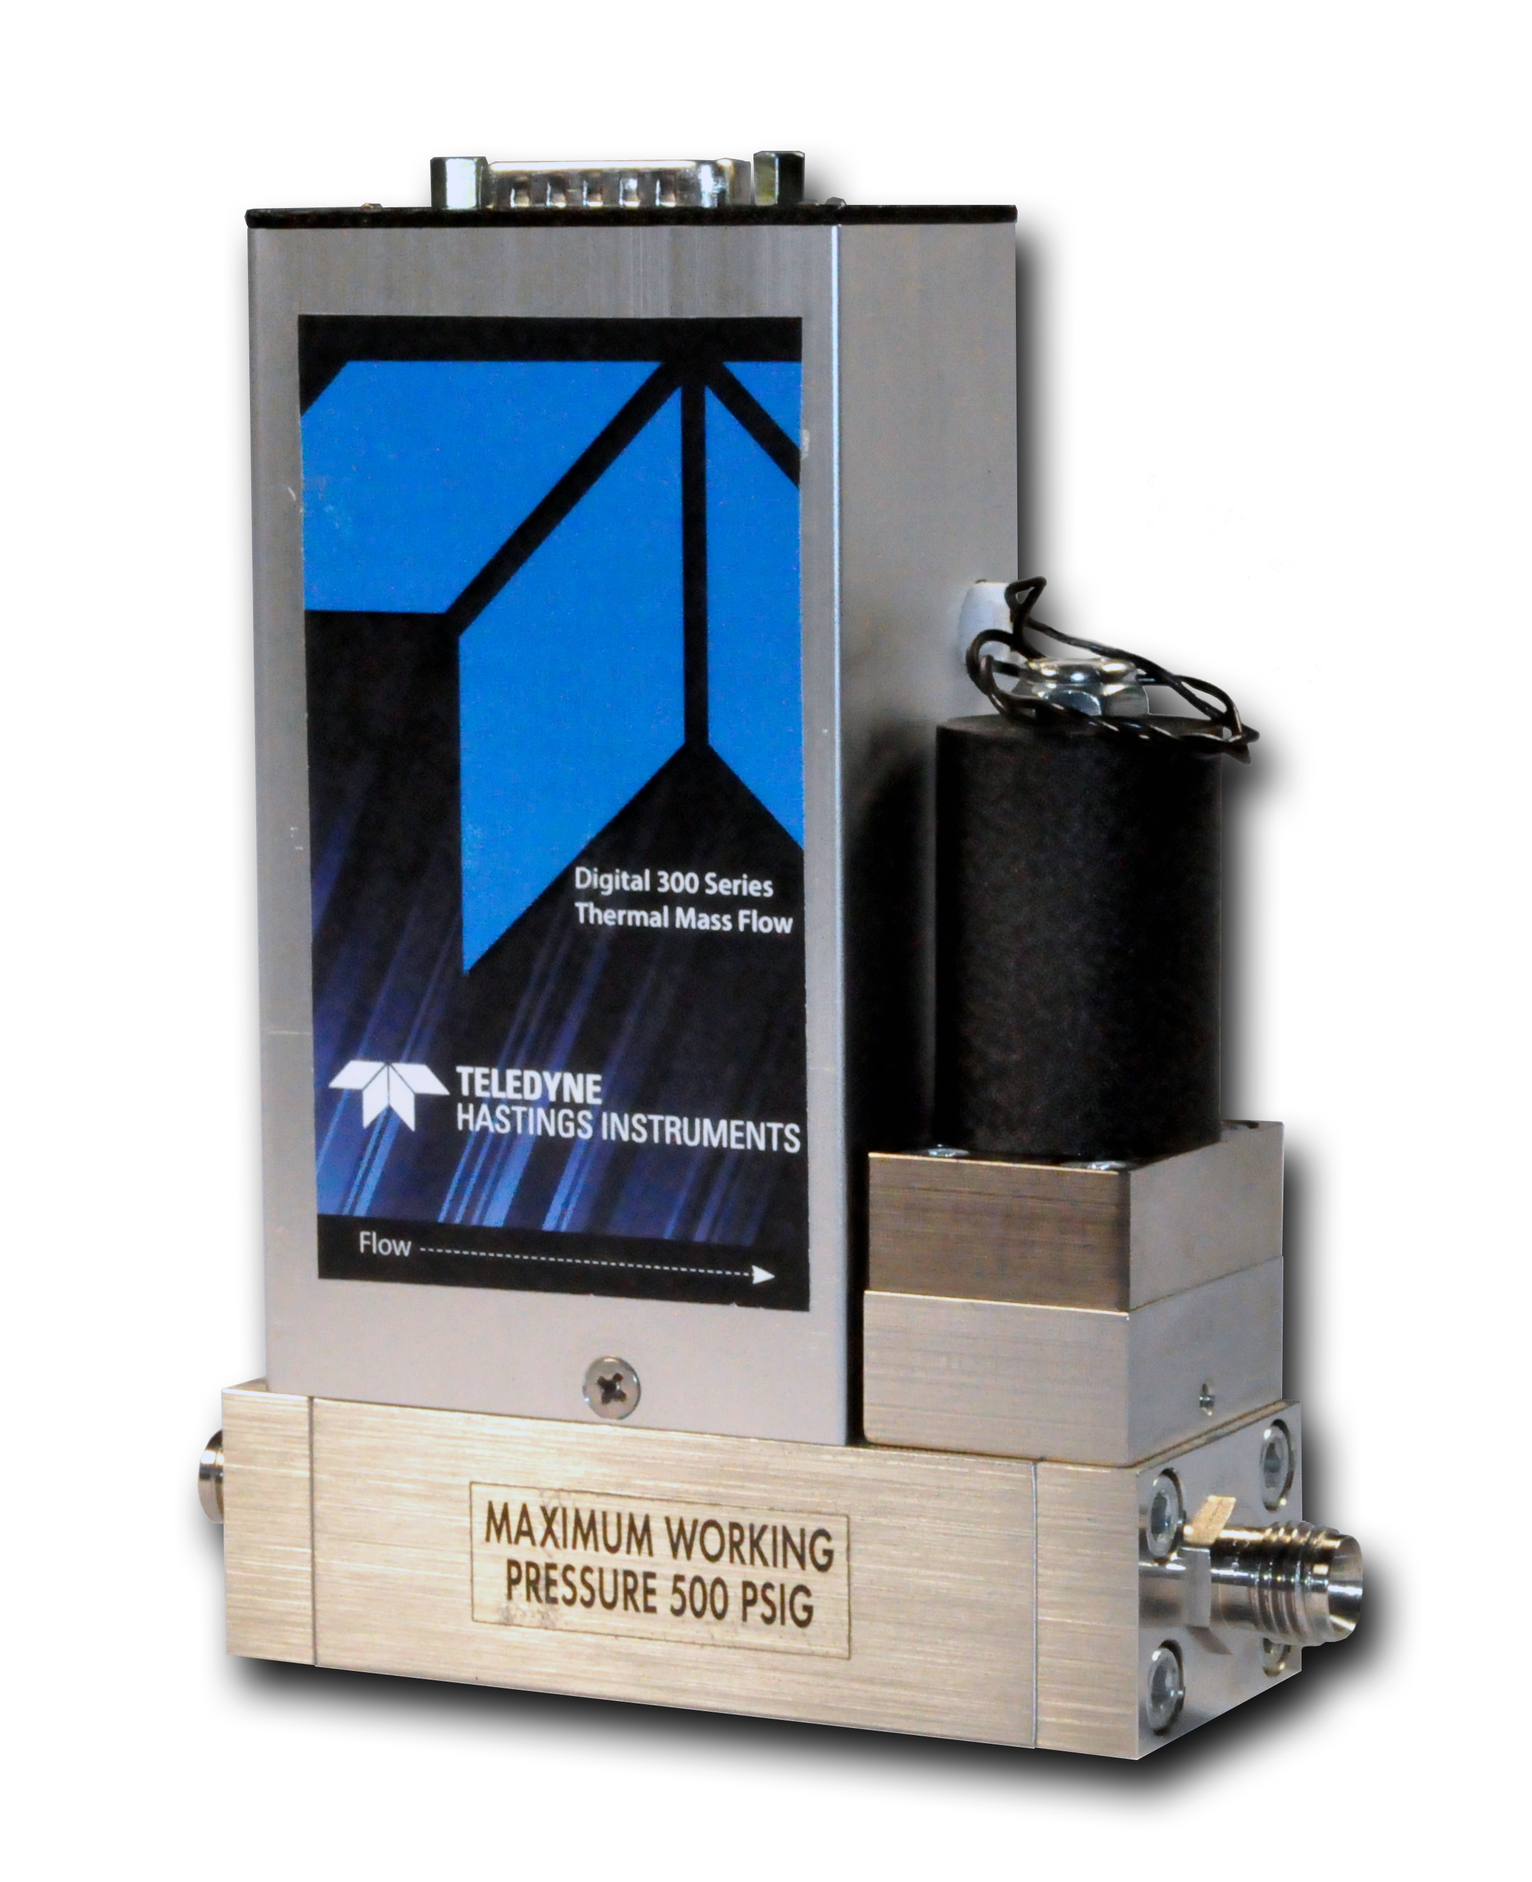
Gas Modulation Technique
Flow-Controller
Programmable Flow Controller is used to create stepwise pressure increase inside the resonator.

Slide 7
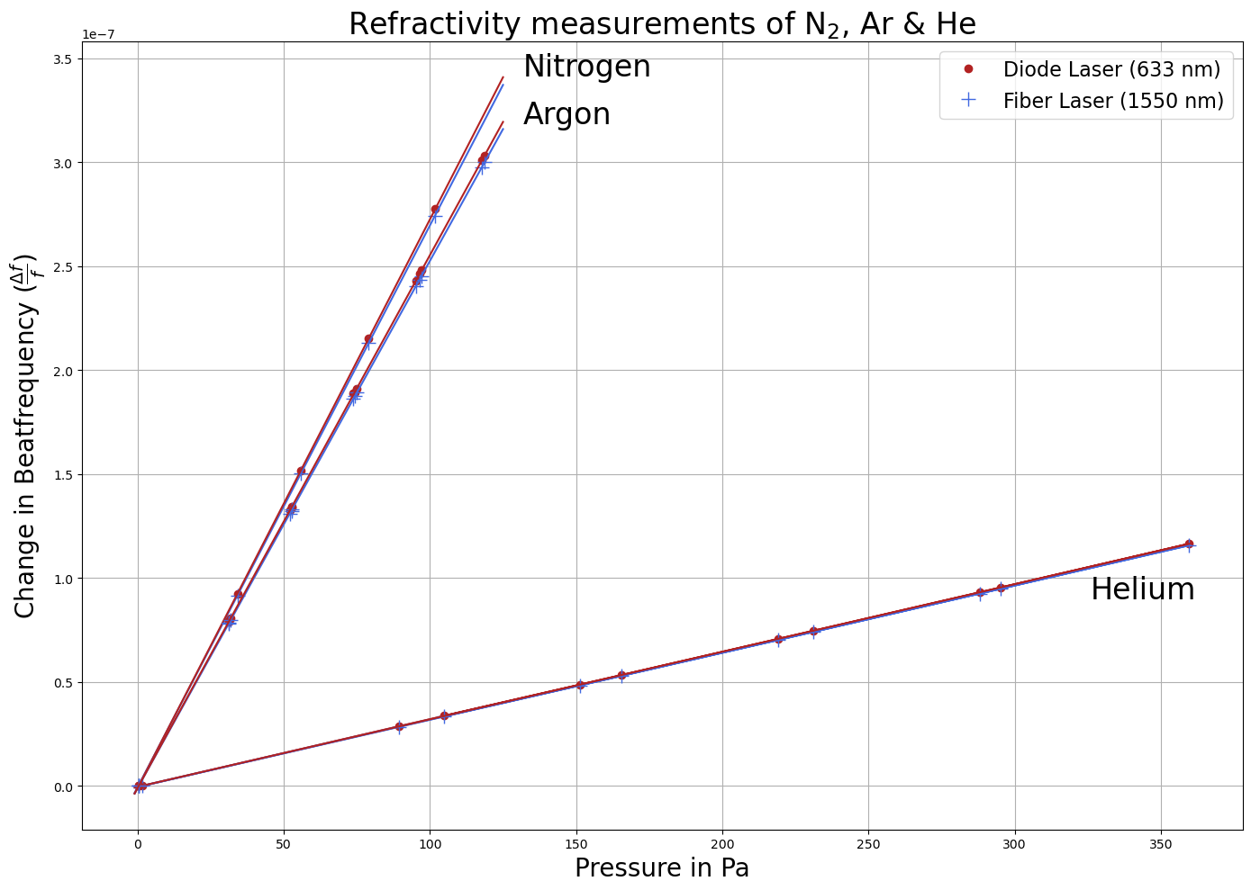
Refractivity Measurements of N₂, Ar & He
Relative frequency change

Slide 8
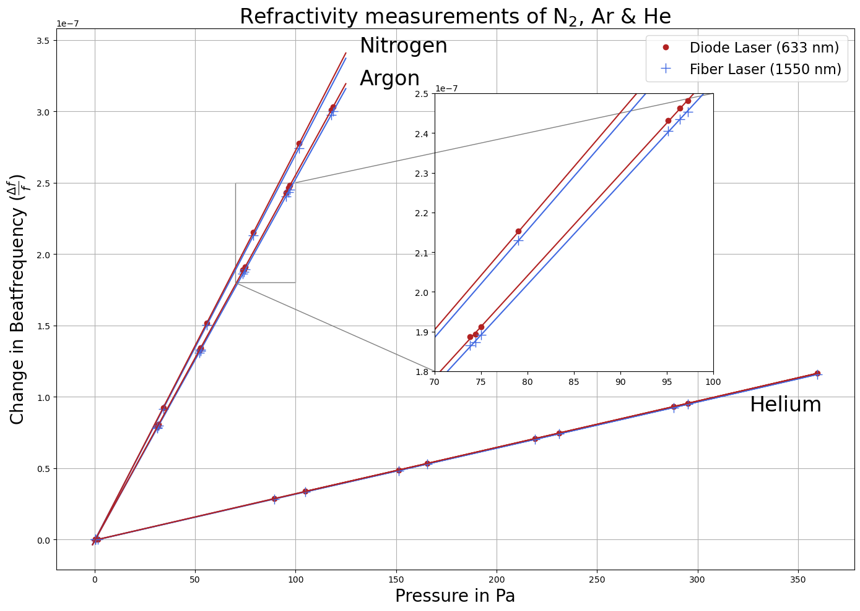
Refractivity Measurements of N₂, Ar & He
Relative frequency change

Slide 9
Refractivity results
Gas | Refractivity (n-1) Experiment @1Pa | Refractivity (n-1) Theory @1Pa
Helium (633 nm) | 3.25 · 10⁻¹⁰ | 3.17 · 10⁻¹⁰
Helium (1550 nm) | 3.23 · 10⁻¹⁰ | 3.15 · 10⁻¹⁰
Nitrogen (633 nm) | 2.73 · 10⁻⁹ | 2.71 · 10⁻⁹
Nitrogen (1550 nm) | 2.71 · 10⁻⁹ | 2.69 · 10⁻⁹
Argon (633 nm) | 2.56 · 10⁻⁹ | -
Argon (1550 nm) | 2.53 · 10⁻⁹ | -

Slide 10
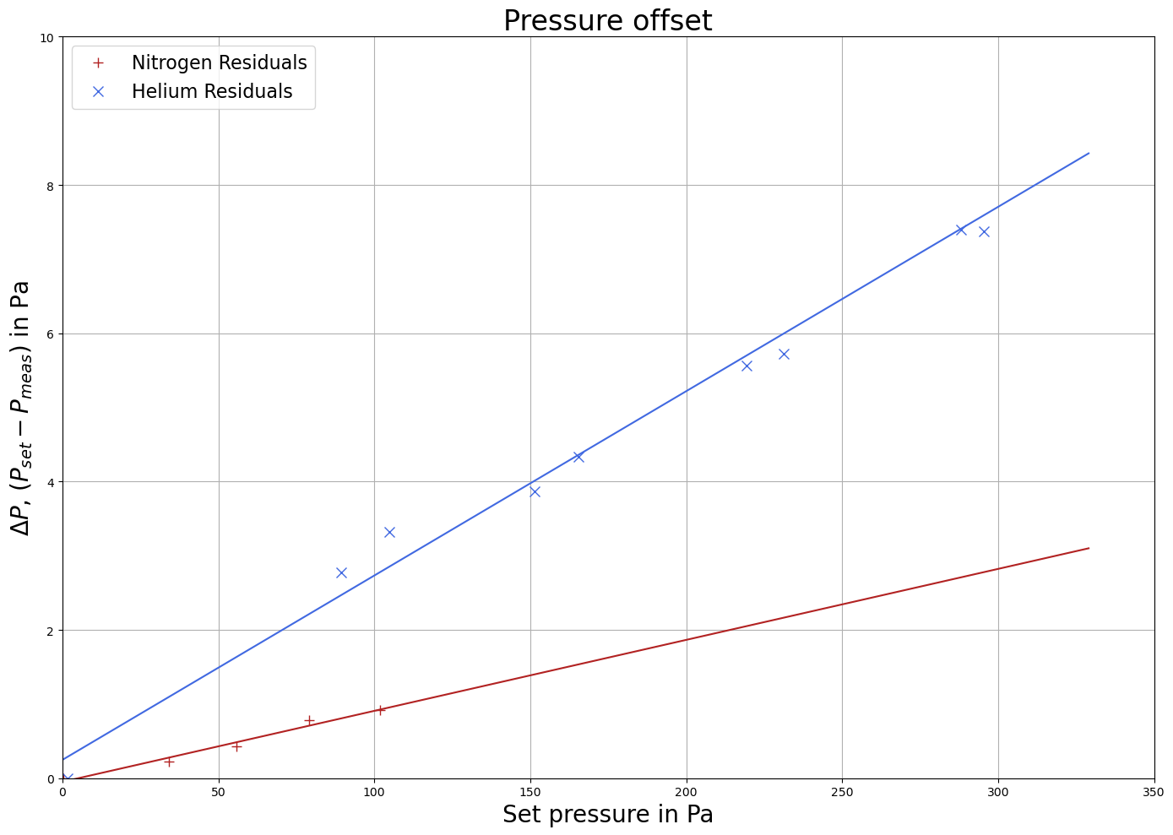
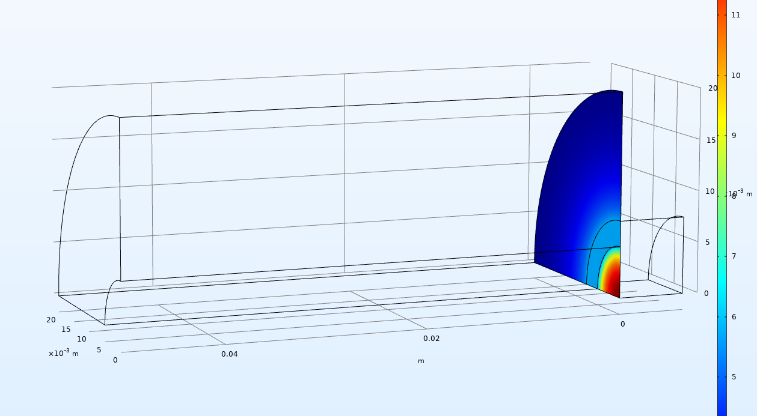
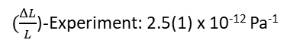
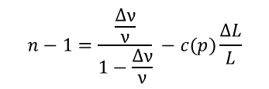
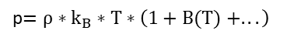
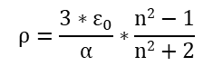
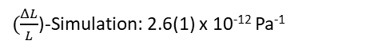
System characterization
Experimental result:
FEM Simulation:
ΔP, Deviation in pressures
Set pressure in Pa
$$n−1=\frac{\frac{Δν}{ν}}{1−\frac{Δν}{ν}} −c(p)\frac{ΔL}{L}$$
Zerodur Resonator:
Refractivity:
$(\frac{ΔL}{L}$)-Experiment: 2.5(1) x 10⁻¹² Pa⁻¹
Gas density:
$$ρ=\frac{3∗ε_{0}}{α}∗\frac{n2−1}{n2+2}$$
$(\frac{ΔL}{L}$)-Simulation: 2.6(1) x 10⁻¹² Pa⁻¹
Partial pressure:
p$=ρ∗k_{B}∗T∗\left(1+B(T) +...\right)$

Slide 11
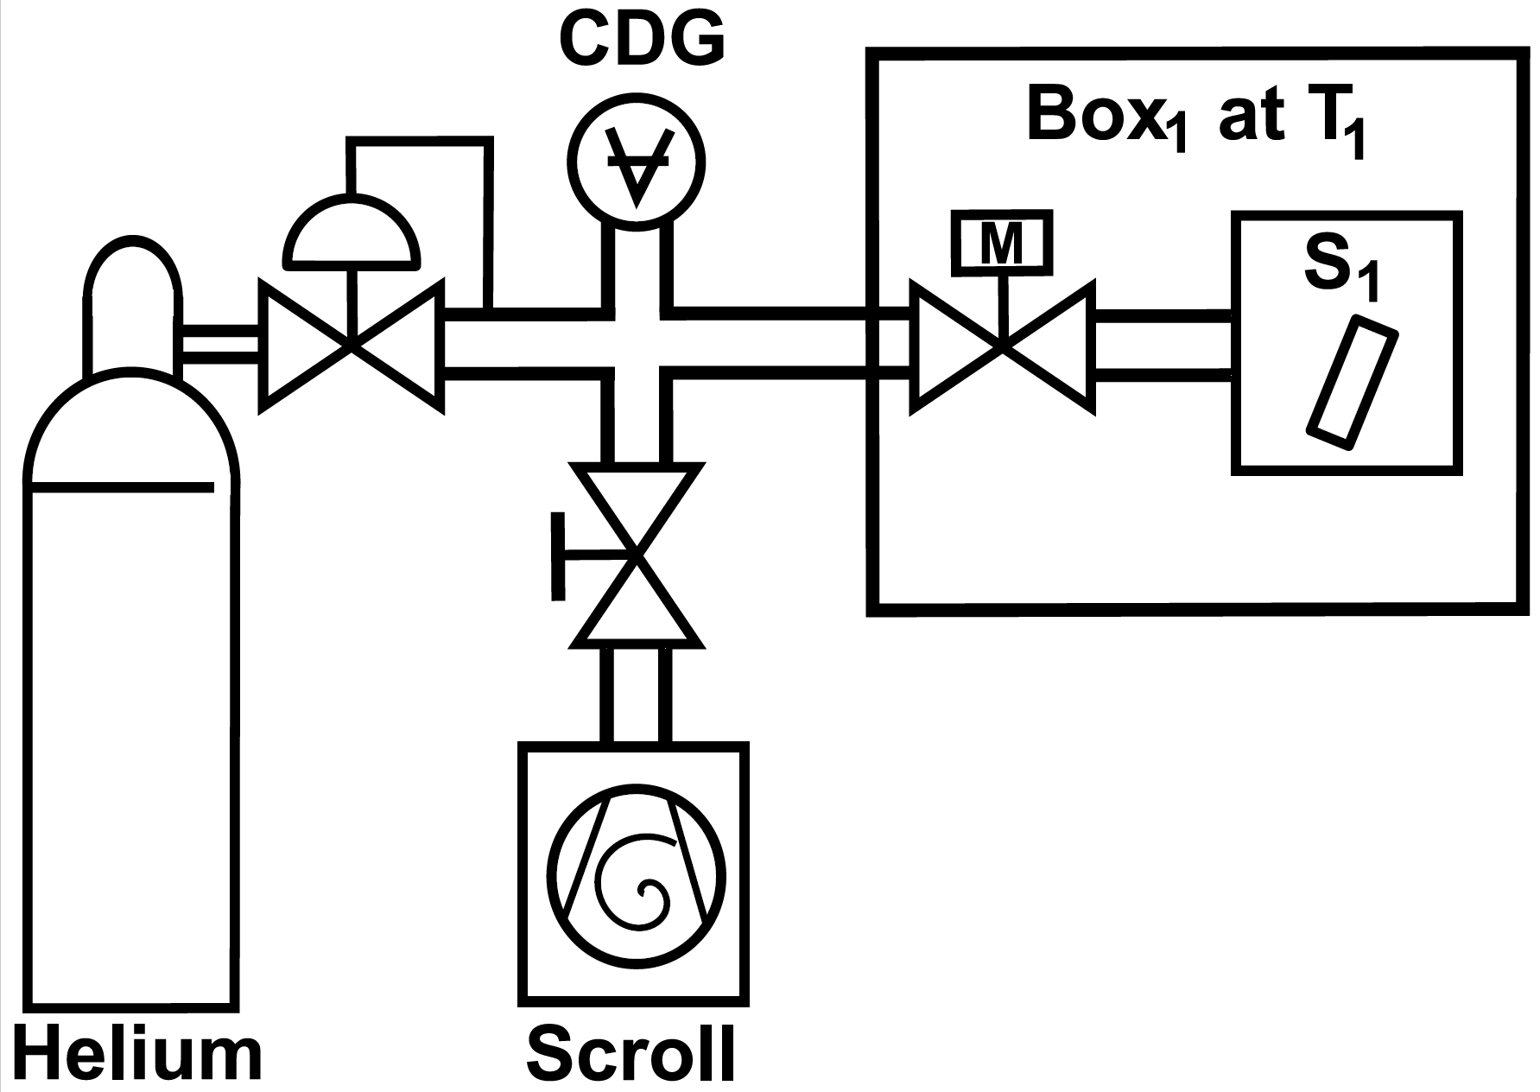
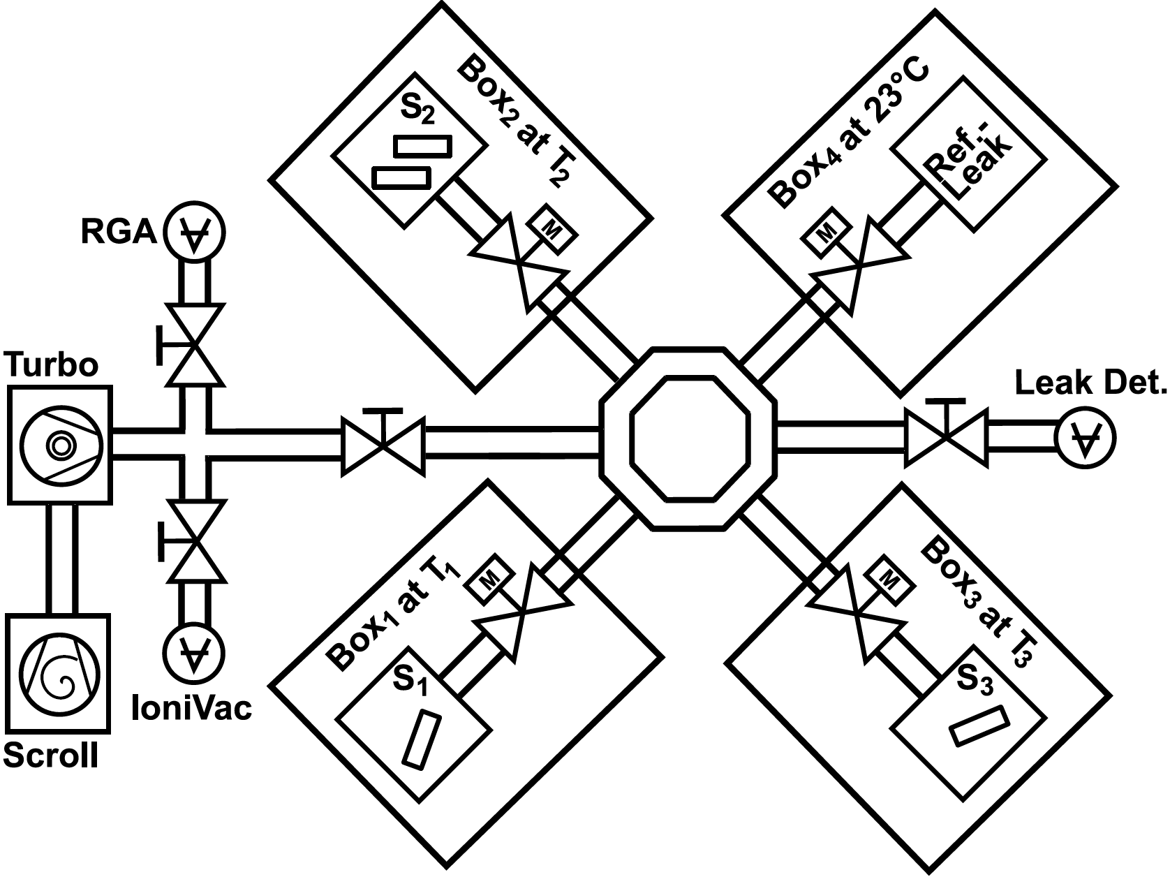
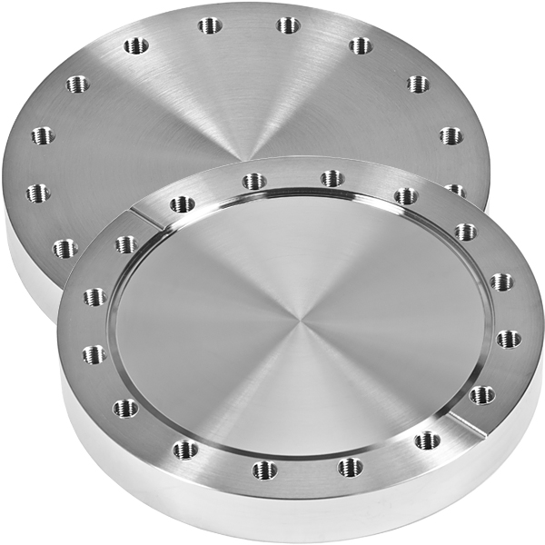
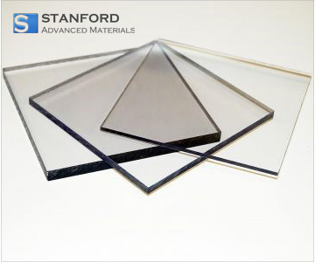
Helium outgassing of Resonator materials
Helium loading
Experimental setup

Slide 12
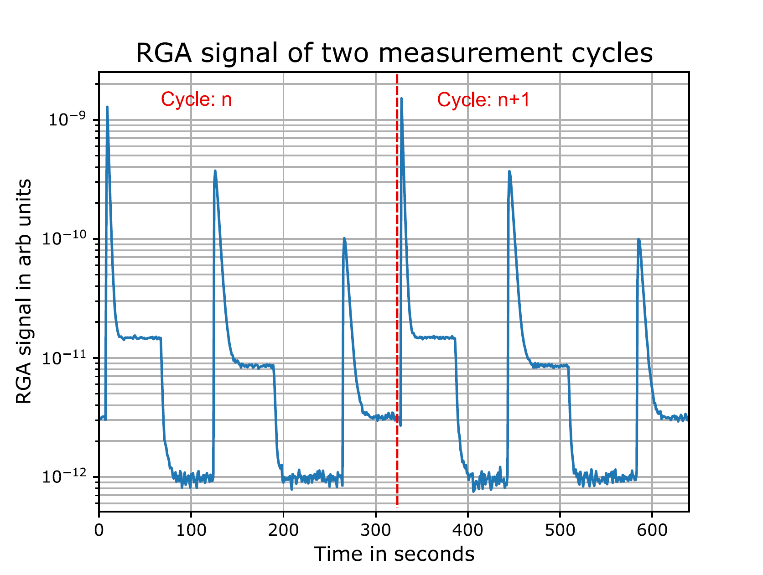
Measurement cycles
Pneumatic valves are periodically opened and closed to connect the different samples to the mass spectrometer.

Slide 13
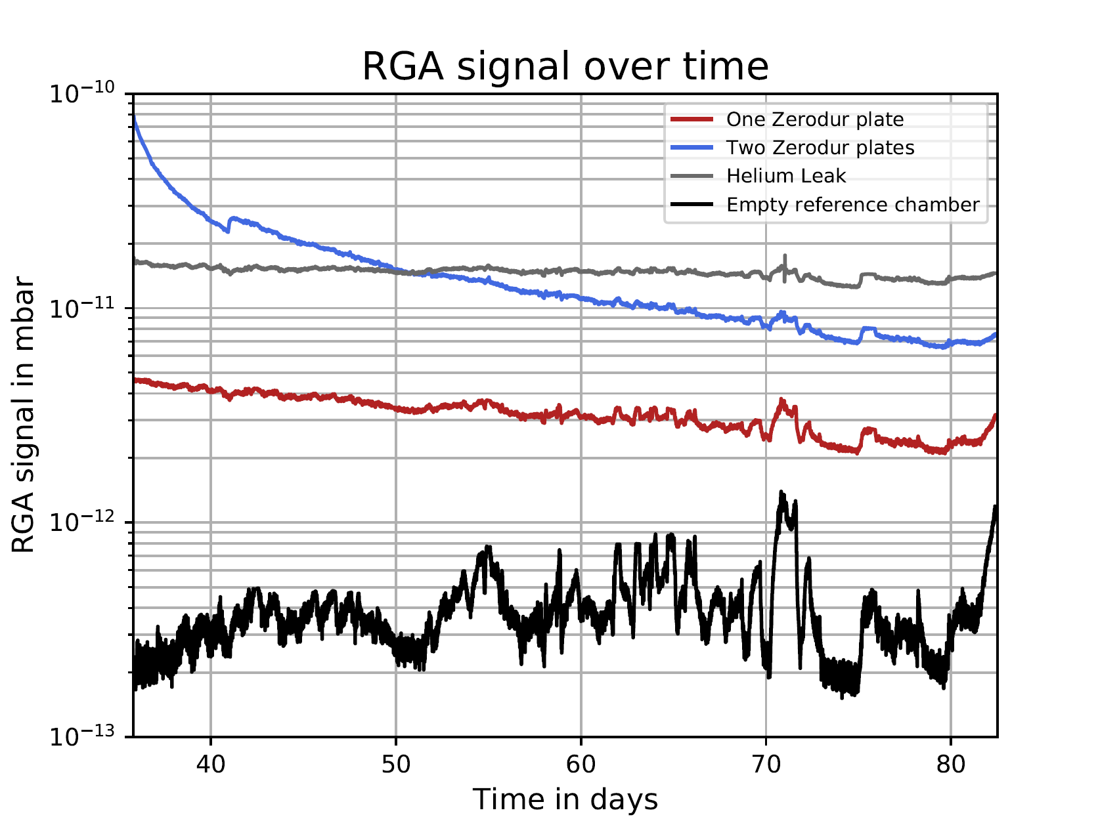
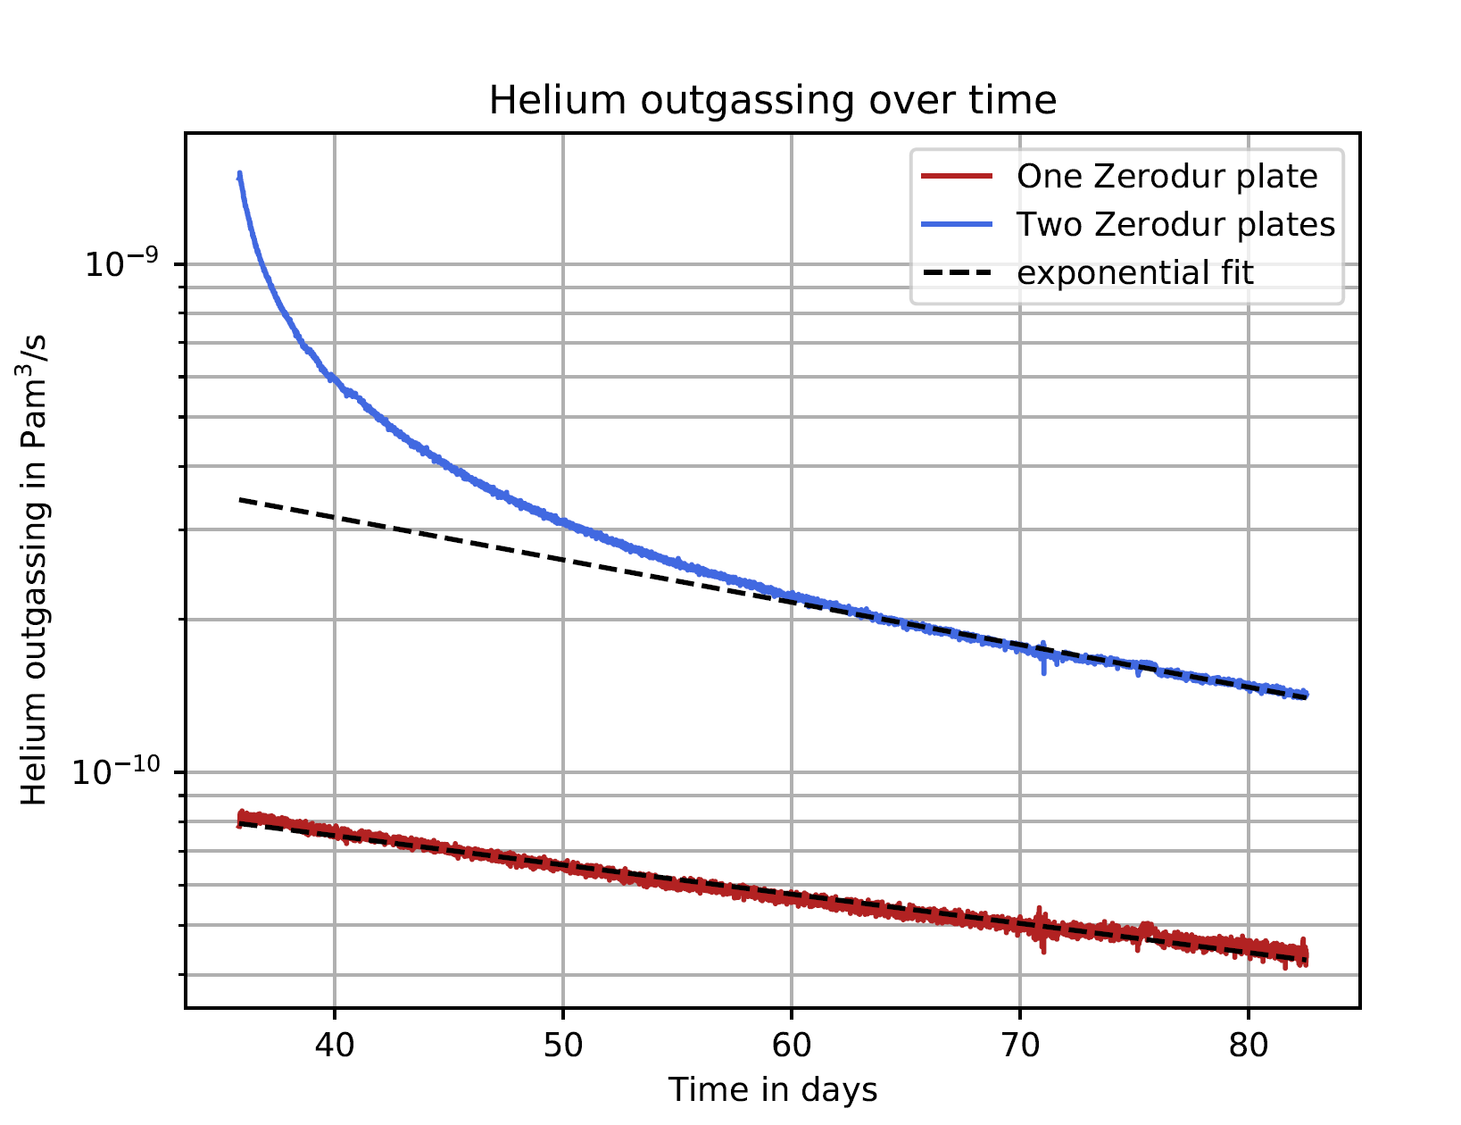
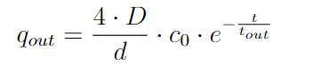
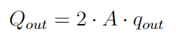
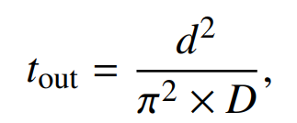
Helium outgassing of Zerodur
Raw data
Calibrated data set.
Q_{out} (t=0) = 3.44· 10⁻¹⁰ Pa m³/s
,

Slide 14
Dispersion-relation & comparison with theory
Sample name | Q_{out} (Pa m³/s) | C₀ (Pa m³/m³) | S (He solubility)
Zerodur, T = 23°C | 3.44 · 10⁻¹⁰ | 56.28 | 65.44 ppm
Zerodur, T = 75°C | 4.22 · 10⁻¹⁰ | 278.92 | 463.5 ppm
ULE, T = 50°C | 1.22 · 10⁻⁶ | 4822 | 14400 ppm
ULE, T = 75°C | 5.37 · 10⁻⁶ | 7330 | 16290 ppm
Saphir, T = 400°C | <1 · 10⁻¹² | - | -

Slide 15
Physikalisch-Technische Bundesanstalt
Braunschweig und Berlin
Abbe Straße 2-12
10587 Berlin
André Kussicke
E-Mail: Andre.Kussicke@PTB.de
www.ptb.de

Slide 16
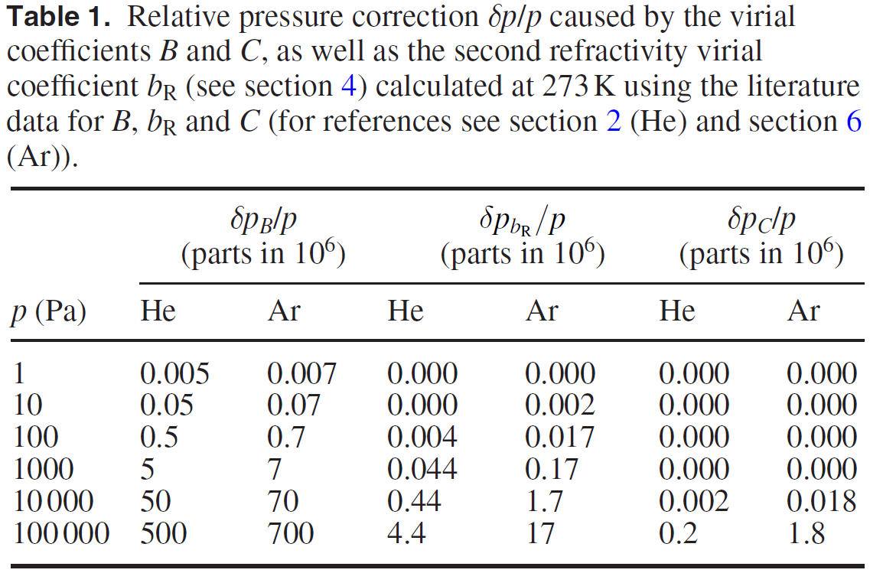
Virialkoeffizienten
Karl Jousten, et al. Perspectives for a new realization of the pascal by optical methods. Metrologia 54 S146 (2017)

